Slide 1
Intro to Data Analysis with Python
For Non-Programmers/ Python Beginners
Pamela Pan, Data Service Fellow
shanghai.library.data@nyu.edu
Fall 2021
NYU Shanghai Library

Slide 2
Welcome to the
third workshop in the
Python Series!
1. Intro to Python
Comments, Variables, Operators, and Statements
2. Intro to Data Structures
Lists, Tuples, Sets and Dictionaries; Iterations and Functions
3. Intro to Data Analysis
with Python
Basic exploratory data analysis
Notes:
Sharing Link
Download link
More about workshops

Slide 3
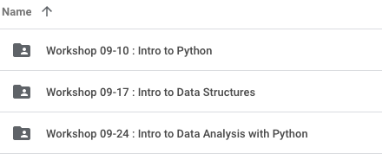
Links
Workshop Drive:
tinyurl.com/nyushlibworkshops

Slide 4
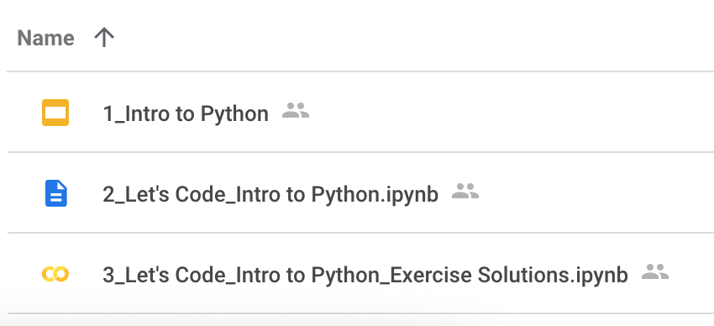
Recap: About Python
What is Python
Why Python
A simple syntax similar to the English language.
Same task, fewer lines of code than other languages.
Uses of Python
Python vs. R
R is mainly used for statistical analysis while Python provides a more general approach to data science
Python Environment
Terminal, Integrated Development Environment (IDE), Interactive Computational Environment (ICE)
Where it is in the Workshop I drive

Slide 5
Recap: Coding with Python
Comments
#
Variables
Numbers
Booleans
Strings
Operators
Statements
If … Elif … Else ...
(Workshop I: Intro to Python)
Collections
Lists, Tuples, Sets, Dictionaries
Iterations and Loops
For loops, While loops
Functions
(Workshop II: Intro to Data Structures)

Slide 6
Data Science Life Cycle
Data Collection
a. File format Data(Spreadsheet, CSV, Text files, XML, jSON)
b. Relational Database (SQL)
c. Non-relational Database (NoSQL)
d. Scraping Website Data using tools
*Big data (i.e. complex data) is characterized by volume, velocity, variety, and veracity.
Goal Definition
What’s the problem?
Business
Social
Academic
...
01
02
06
Data Processing
Interpretation & Decision Making
Often takes up to 80% of the time.
03
Exploratory
Data Analysis
Visualization
05
04
a. Descriptive analytics
b. Predictive analytics
c. Prescriptive analytics
Notes:
Define the Goal
A goal could stem from business, social, academic settings, or scenarios in any discipline.
Data Collection
Data might need to be collected from multiple types of data sources:
a. File format Data(Spreadsheet, CSV, Text files, XML, jSON)
b. Relational Database
c. Non-relational Database(NoSQL)
d. Scraping Website Data using tools
When speaking of data collection, the term “Big Data” often comes up.
Characterized by a few properties (volume, velocity, variety, veracity).
Which corresponds to the size of the data, the speed in which it is generated and collected, its structures, and its quality.
Data Processing
Or data cleaning. Involves the identification of various data quality issues.
Removing discrepancies, e.g. missing data
This is also the point where if you feel the data is not proper or enough for you to proceed you go back to the data collection step.
Data Exploration
Perform analysis, including:
a. Descriptive analytics (describing what has happened in the past)
b. Predictive analytics (what could happen in the future)
c. prescriptive analytics (what we should do)
Visualization
In the world of data visualization, a picture is worth not only a thousand words, but a thousand petabytes!
At this stage we need to consider the functionality and aesthetics for better conveying the results of data analysis.
Interpretation & Decision Making
Provide the readers what the graph means, often by telling the story of contexts, implications, and possible outcomes.
Based upon all the insights we have gathered through observation of data or through machine learning model’s result, we get into a state where we can make some decisions regarding any business problem at hand.

Slide 7
Python packages we’ll use today
Data Manipulation
NumPy (Cheat Sheet)
Pandas (Cheat Sheet)
Data Visualization
Matplotlib (Cheat Sheet)
Notes:
NumPy, the fundamental library for scientific computing in Python
The Pandas library is built on NumPy, and it allows data scientists to do more types of data manipulation and analysis,
Lastly, Matplotlib is a visualization library for scientific analysis

Slide 8
Let’s code!
Download workshop notebook via this link

Slide 9
More Study Resources
The official website of Python: https://www.python.org/
Python for Everybody: https://www.py4e.com/lessons
W3 Schools: https://www.w3schools.com/python/default.asp
freeCodeCamp: https://www.freecodecamp.org/learn/scientific-computing-with-python/

Slide 10

Thank you!
Contact: shanghai.library.data@nyu.edu
Data Services @ NYU Shanghai Library
Other workshop resources:
👉 https://nyu-shanghai-data-services.github.io/resources/
Feedback form
tinyurl.com/libworkshopfeedback

